Slide 1
Employee Data Analysis using Excel
STUDENT NAME: SHALINI R
REGISTER NO:71265B4382B5D0EB61E493C00089CF47/312208771
DEPARTMENT: B.Com (GENERAL)
COLLEGE: MEENAKSHI COLLEGE FOR WOMEN

Slide 2
PROJECT TITLE
Employee Performance Analysis Based on Gender Salary FTE using Excel

Slide 3


AGENDA
Problem Statement
Project Overview
End Users
Our Solution and Proposition
Dataset Description
Modelling Approach
Results and Discussion
Conclusion
3/21/2024 Annual Review

Slide 4

PROBLEM STATEMENT
Maria, a dedicated employee in the Human Resources department, is facing an issue regarding her salary. Despite her
consistent hard work and significant contributions to the
company, she has noticed discrepancies in her paycheck over the past few months. As a female employee who has been with the company for over five years, Maria is concerned that these
salary issues might be due to an oversight or, worse, a potential
gender pay gap. She is seeking clarification and resolution to
ensure her compensation reflects her role and experience
accurately.

Slide 5

PROJECT OVERVIEW
.
The project aims to analyse FTE (Full-time employee) on both men and women employees at various departments . The full time and part time employees to identify and address under the table. By conducting this analysis the company came to who are the employees working more hours and less hours in the company
﻿

Slide 6

WHO ARE THE END USERS?
The end users of this project in female employees at various levels within the company, ranging from entry-level to senior management. These employees,whether full-time or part-time, will benefit directly from the analysis as it seeks to address any disparities in their salaries. Additionally, department heads and Human Resources personnel are key end users, as they will use the findings to implement fair compensation practices and ensure equitable pay across all departments. The ultimate goal is to create a more transparent and just salary structure that positively impacts the work experience and satisfaction of all employees, particularly focusing on those who may be affected by salary imbalances.

Slide 7

OUR SOLUTION AND ITS VALUE PROPOSITION
Our solution involves implementing a comprehensive salary
audit and realignment strategy designed to address disparities and ensure fair compensation across all female employee and departments. By conducting a detailed analysis of salary data, job roles, and performance metrics, we will identify any imbalances, particularly focusing on female employees who may be affected by pay gaps. The value proposition of this solution lies in its commitment to promoting equity and transparency within the organization.

Slide 8
Dataset Description
The dataset provides a detailed overview of female employees within the organization, encompassing key variables such as salary and department. The dataset categorizes female employees across various departments, allowing for an analysis of salary distributions within and between departments. It includes data points such as base salary, bonuses, and any additional compensation. By analyzing this dataset, we can assess pay equity among female employees, identify potential discrepancies across different departments, and develop targeted strategies to ensure fair and competitive compensation practices.

Slide 9

THE "WOW" IN OUR SOLUTION
Effective data visualization makes it easier to present complex data in an engaging and understandable way.
3/21/2024 Annual Review
9

Slide 10
﻿
•Open employee data set and download it.
•Then open the employee dataset in excel.
﻿•select all the data in excel.
﻿•Then click the insert and open pivot table.
•﻿Drag the need data and create a pivot table.
﻿•Select the pivot table and click on insert.
﻿•Now click on the chart that you want.
﻿•The chart is created.
﻿
MODELLING
10

Slide 11
RESULTS 1.TABLE
11

Slide 12
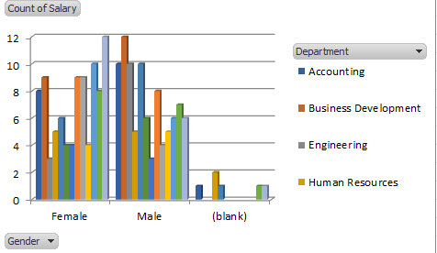
2. BAR DIAGRAM

Slide 13
conclusion
In conclusion the Business Development and Services departments have a higher concentration of male employees, whereas females are more represented in Training and Research and Development. Overall, the workforce appears to be fairly balanced in terms of gender distribution across most departments, though specific fields such as Engineering and Support are male-dominated, while Training has more female employees.

